Slide 1
Undulator Preliminary Pulsedwire

Slide 2
Keep trajectory straight…
I tuned trajectory in couple points to make straight.
Also, no reason not to adjust entrance/exit section at offsets if kick is giving too large waves on wire.
Initial post position:
X1=2.250mm
Y1=19.250mm
X2=11.150mm
Y2=9.750mm

Slide 3
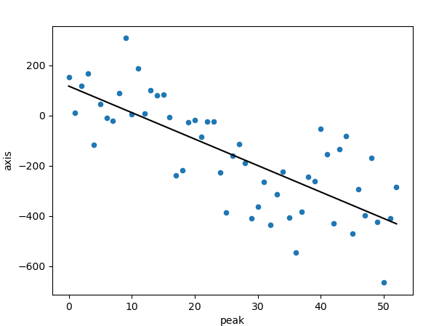
First iteration: xoffset, ytraj
Only measure -1000, 0, 1000 offsets.
Fit suggests adjustments:
Dx1 = -900
Dx2 = 550
New post positions:
X1=1.350mm
Y1=19.250mm
X2=11.700mm
Y2=9.750mm

Slide 4
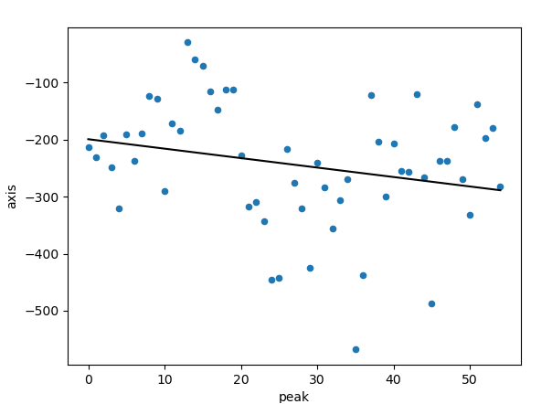
First iteration: yoffset, xtraj
Only measure -1000, 0, 1000 offsets
Fit suggests adjustments:
Dy1 = 50
Dy2 = 300
New post positions:
X1=1.350mm
Y1=19.300mm
X2=11.700mm
Y2=10.050mm

Slide 5
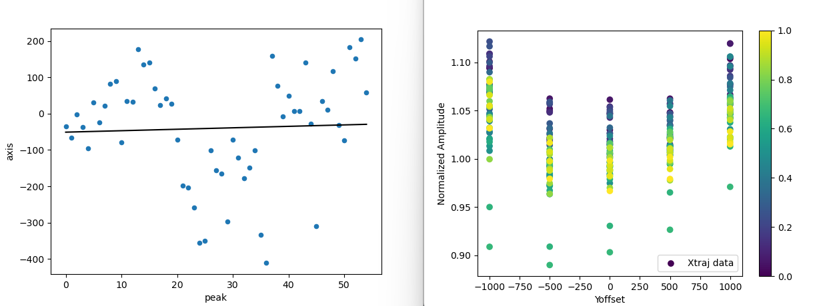
Second iteration: yoffset, xtraj
Realized I made adjustments in wrong direction (sign error).
Adjusted dy2=-1000 and now results suggest no adjustment needed.
Can see effects of sag maybe?
Measured -1000, -500, 0, 500, 1000.
I preemptively correct the sign error in xoffset as well:
Dx1 =1800
Dx2 = -1100
New post positions:
X1=3.150mm
Y1=19.300mm
X2=10.600mm
Y2=9.050mm

Slide 6
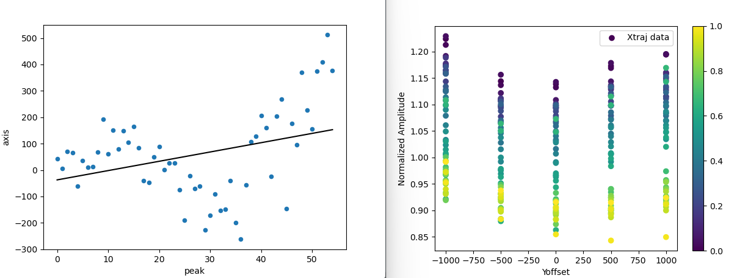
Second iteration: xoffset, ytraj
Measured -1000, -500, 0, 500, 1000.
Similar nonlinearity to yoffset, maybe this isn’t sag, just due to errors in calibration.
I only adjusted entrance angle, so trajectory became quadratic at times.
Adjustments not worth making..
Final post positions:
X1=3.150mm
Y1=19.300mm
X2=10.600mm
Y2=9.050mm

Slide 7
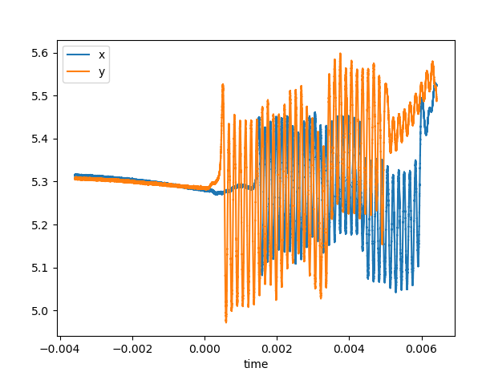
Final preliminary trajectories
text

